Slide 1
Sunshine Dairy Shop
Presentation By : Stuti B Prajapati (Roll No:34)
: Yash S Panchal (Roll No:42)

Slide 2
Outline
Project Profile
Introduction
Abstract
Aims & Objectives
Scope Of Project
Project Description
Requirement Analysis
Feasibility Study
Introduction PHP
System Features
System Design
Table Definition
Conclusion
//system Testing, system Implementation, system Maintenance

Slide 3
Project Profile
Project Title: | Sunshine Dairy Shop
Objective: | Automate the complete operations DSMS
Operating System: | Windows 10 Pro for Workstations
Front End Tool: | Notepad
Back End Tool: | XAMPP,MYSQL
Project Guide: | Neeluben Rathod
Submitted By: | Stuti B Prajapati Yash S Panchal
Submitted To: | Sardar Patel University

Slide 4
Introduction
This Project deals with the management of the Computerized Dairy Shop Management Solution.
Our main goal is to develop this application to encourage the dairy industry to go online and technology ready.
Dairy Shop Management System is a web application to maintain day to day transactions in a Dairy Shop.
Dairy production is an important component of livestock farming. The mission of the Dairy Shop Management System is to create communication between rural area
people and dairy management.

Slide 5
Abstract
It deals with the sale of milk and milk products and by making records in the database.
All create, read, update and delete operations are supported in this project for complete representation.
Dairy Shop Management System allows you to view the details of the sales. It contains the information of the stocks and sales.
Automate the current manual bill generation system and maintain the data security, user rights.

Slide 6
Aims & Objectives
The project describes the goods information of their efficiency cost.
For easy and convenient processing, we developed the web application which works as per our requirements.
It should have options for future modifications in the database i.e. the goods list & new items.
The main objective of this application is to automate the complete operations of a dairy shop. They need to maintain the records of products. Also searching should be very faster so they can find required details instantly.

Slide 7
The project maintains two level :
  Administration level
  User level (Customer)
Main facilities available in this project are :
  Security of data
  Ease of data recording
  Generates information in less amount of time

Slide 8
Scope of Project
This application is built such way that it should suits for all type of dairy product in future .
Dairy shop management system is consists of complete customer relationship management system.
Dairy shop management system project is a web application useful for dairy farms for managing dairy activities like receiving of dairy product from various sources.

Slide 9
Project Description
Existing system
The existing comprises of old-dairy transaction dealings and does not have any digital records of the transaction.
This method is highly volatile as the records could be easily lost due to human error and could cause a variety of problems.
The client to do this process manually wastes a lot of time and money.

Slide 10
Proposed System
Our solution is to make the system digital and automated to reduce the labors hours and nullify human errors as much as possible.
Proposed System is an automated Dairy Shop Management System.
Our proposed system has following advantages:
  User friendly interface
  Fast access to database
  Less error
  More storage capacity
  Search facility
  Look and feel environment

Slide 11
Requirement Analysis
Hardware Requirement
Below is the hardware we required to build the system
  Installed RAM : 8.00 GB (7.75 GB usable)
  Processor : Intel(R) Core(TM) i5-10500 CPU @ 3.10GHz 3.10 GHz
  System type : 64-bit operating system, x64-based processor

Slide 12
Software Requirement
Front-End:
  The web application required to design the user interface and user experience i.e. front end given below.
  Notepad: we used this web application to mainly edit and integrate webpage based on PHP, HTML, CSS and JavaScript.
Back-End :
  The main technology is used for storing and managing databases is a MYSQL that provides online database storage options along with “phpMyAdmin”. MYSQL is the programming language used for backend.

Slide 13
Feasibility Study
Operational feasibility:
  People needed much functionality from which we managed to make main functionalities available.
Economic feasibility:
  The effectiveness of the proposed system is very essential because the main goal of the proposed system is to have economically better result along with increased efficiency.
Technical feasibility :
  The main consideration is to be given to the study of available resources of the organization where the software is to be implemented.

Slide 14
Introduction to PHP
PHP is an acronym for “PHP: Hypertext Preprocessor” & Personal Home Page. It is a widely-used, open source scripting language. Scripts are executed on the server.
PHP is basically used for developing web bases software application. PHP is an interpreted language, i.e., there is no need for compilation. It is faster than other scripting language, for example, ASP and JSP.
PHP runs on various platforms (Windows, Linux, Unix, Mac OS X, etc.)
PHP is compatible with almost all servers used today (Apache, IIS, etc.)
PHP code are executed on the server and the result is returned to the browser as plain HTML.PHP files have extension “.php”.
PHP Features:
  Performance
  Open source software
  Platform independent
  Compatibility
  Embedded

Slide 15
System Features
Registration/login
Admin
  Dashboard
  Category
  Company
  Product
  Search
  Invoices
  Reports
  Profile
User
  Search
  Invoices
  Profile

Slide 16
System Design
A data dictionary is a collection of description of the data objects in a data model for the benefit of programmers and others who need to refer to them.
Often a data dictionary is a centralized metadata repository.
A first step in analyzing a system of interactive objects is to identify each one and its relationship to other objects.
This process is called data modeling and results in a picture of object relationships.

Slide 17
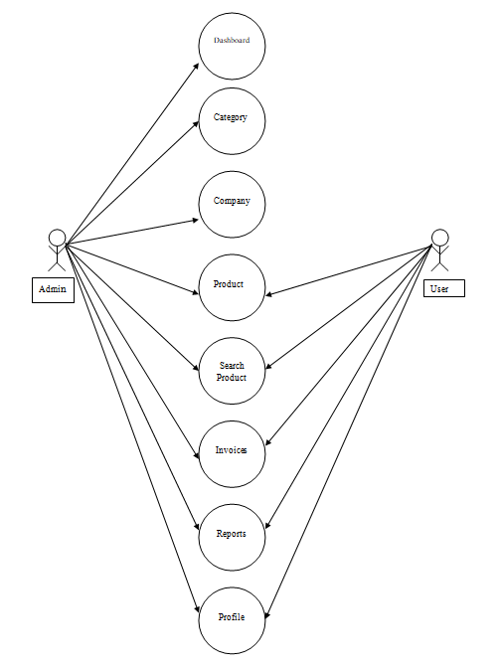
Use Case

Slide 18
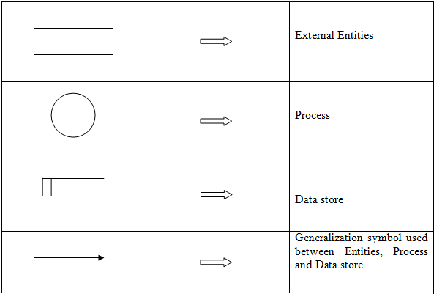
Data Flow Diagram Symbols

Slide 19
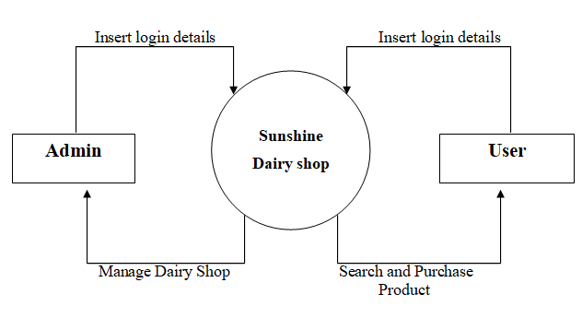
Context-Level DFD

Slide 20
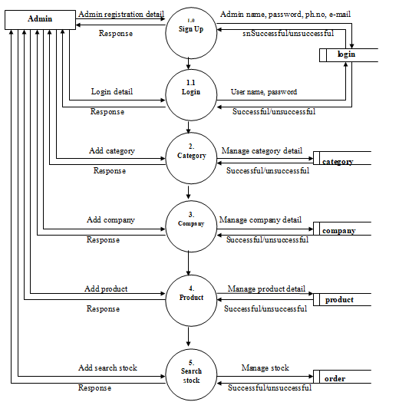
Admin Zero-Level DFD

Slide 21
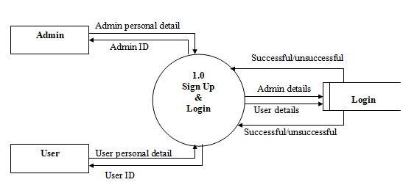
Sign Up / Login DFD

Slide 22
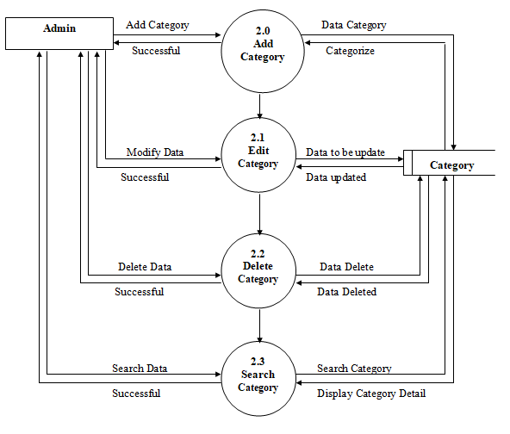
First Level DFD of Process 2.0
[category (Add/Manage)]

Slide 23
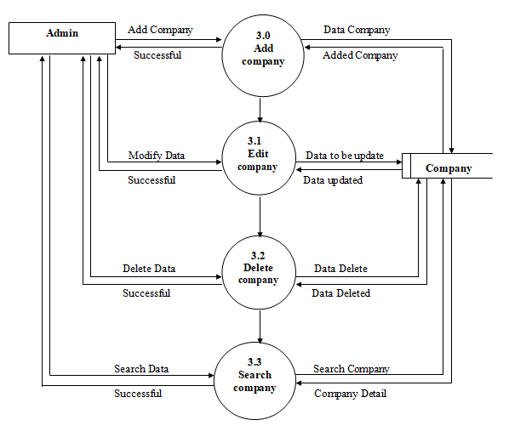
First Level DFD of Process 3.0
[company (Add / Manage)]

Slide 24
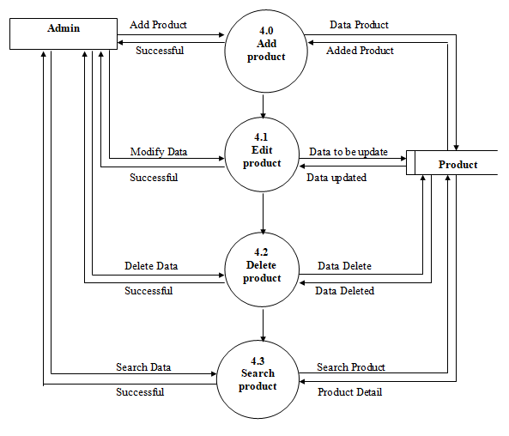
First Level DFD of Process 4.0
[Product (Add / Manage)]

Slide 25
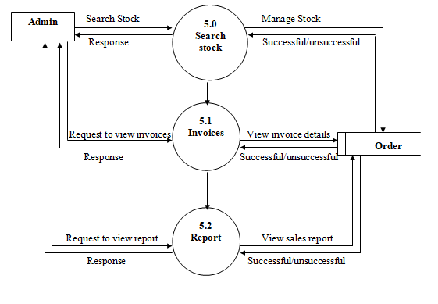
First Level DFD of Process 5.0 (Search stock)

Slide 26
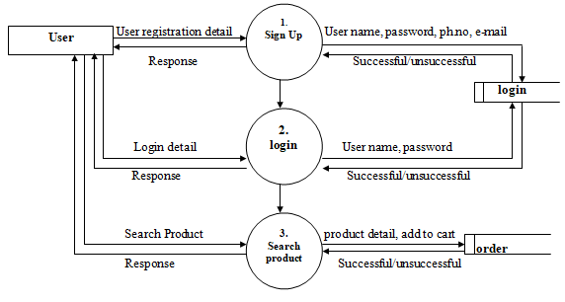
User Zero-Level DFD

Slide 27
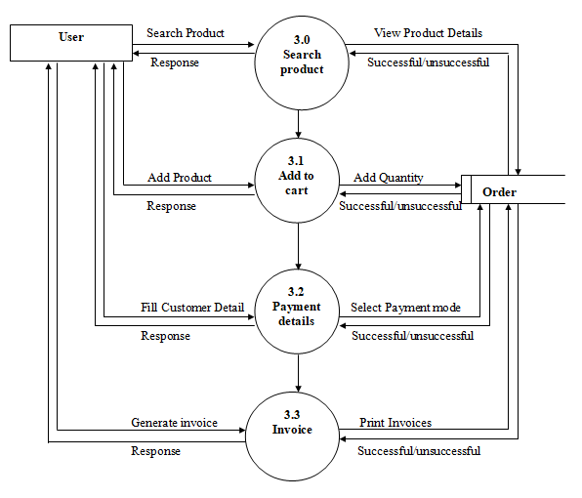
First Level DFD of Process 3.0 (Search product)

Slide 28
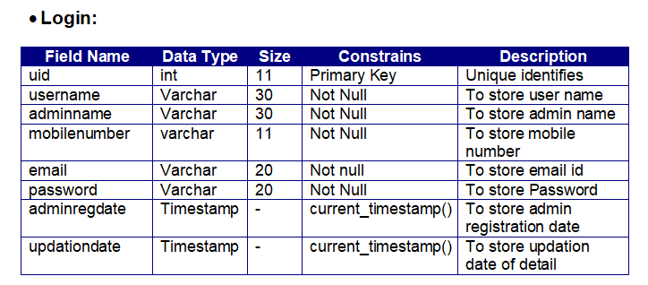
Table Definition

Slide 29
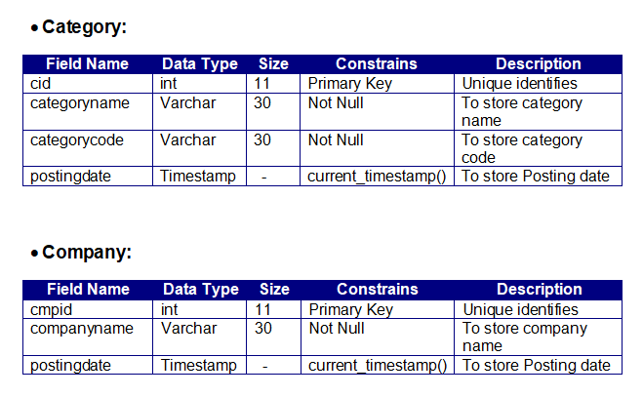

Slide 30
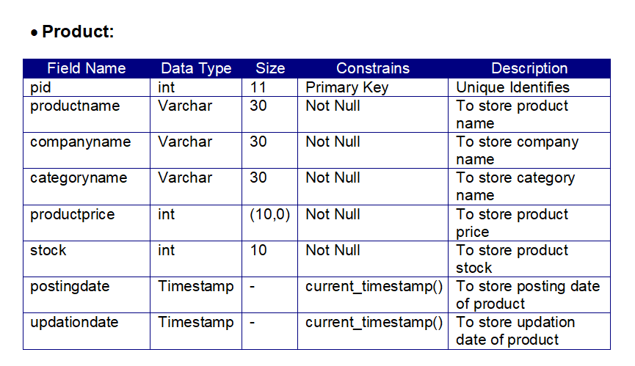

Slide 31
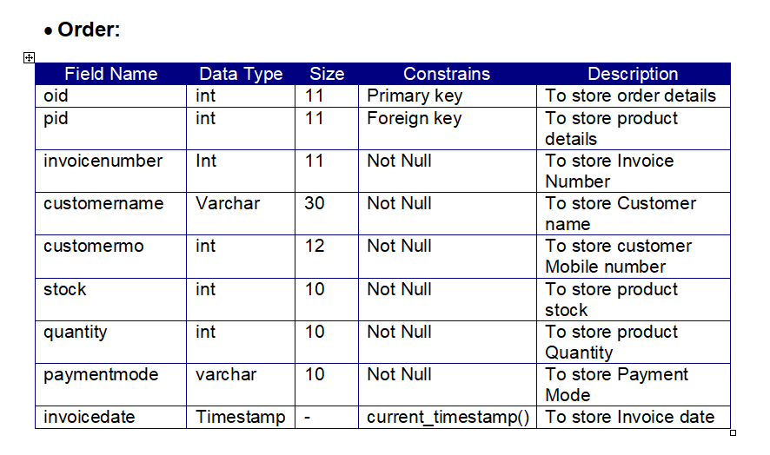

Slide 32
Conclusion
The evidence gathered in this report reflects ongoing progress toward more openness in shop automation system, but also that much work remains.
We see a variety of options and opportunities. Shops that expect to work with their automation system as delivered and not become involved in local extensions or programming will find that the majority of systems were built for that kind of use.
For shops that want to do more with their automation systems, however, we see a great deal of functionality possible today through open interfaces with momentum toward creating much more.

Slide 33
Thank You

